Slide 1

Web Development Lecture 02
Mr. Niaz Mir Khan
Lecturer in Computer Science
__________________________________________________
Department of Computer Science
Govt: Degree College Jamrud, District Khyber

Slide 2
Links path to pages on same server
Link path to page/documents on the same server
<a href=“http://www.linkAddress.com">LinkText </a>
<a href=“anotherPage.html">LinkText</a>
anotherPage.html is in the same directory
<a href=“folderName/anotherPage.html">
anotherPage.html is in sub-directory
<a href="../anotherPage.html">
anotherPage.html is in parent-directory

Slide 3
Link to location in the same document
<h1>Table of Contents</h1>
<p><a href="#section1">Introduction</a><br />
<a href="#section2">Some background</A><br />
<a href="#section2.1">Project History</a><br />
...the rest of the table of contents...
<!-- The document text follows here -->
<h2 id="section1">Introduction</h2>
... Section 1 follows here ...
<h2 id="section2">Some background</h2>
... Section 2 follows here ...
<h3 id="section2.1">Project History</h3>
... Section 2.1 follows here ...

Slide 4
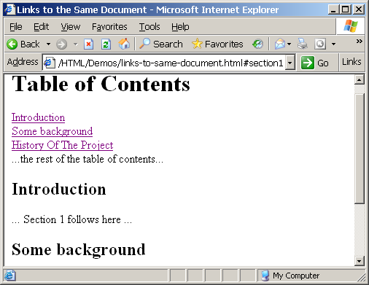
.

Slide 5
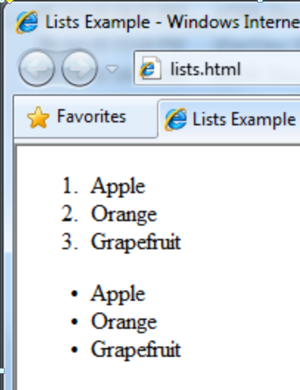
Lists: Ordered List / Unordered List
<ol type="1">
<li>Apple</li>
<li>Orange</li>
<li>Grapefruit</li>
</ol>
<ul type="disc">
<li>Apple</li>
<li>Orange</li>
<li>Grapefruit</li>
</ul>

Slide 6
Ordered List types
<ol type="1">
<li>Apple</li>
<li>Orange</li>
<li>Grapefruit</li>
</ol>
<ol type="1">
Type=1 ➔ 1,2,3,4,5…
Type=A ➔ A,B,C,D…
Type=a ➔ a,b,c,d,…
Type=I ➔ I,II,III,IV,…
Type=i ➔ i,ii,iii,iv

Slide 7
Unordered List types
<ul type="disk">
<li>Apple</li>
<li>Orange</li>
<li>Grapefruit</li>
</ul>
Type value can be disc, circle or square
Apple
Orange
Pear
Apple
Orange
Pear
Apple
Orange
Pear

Slide 8
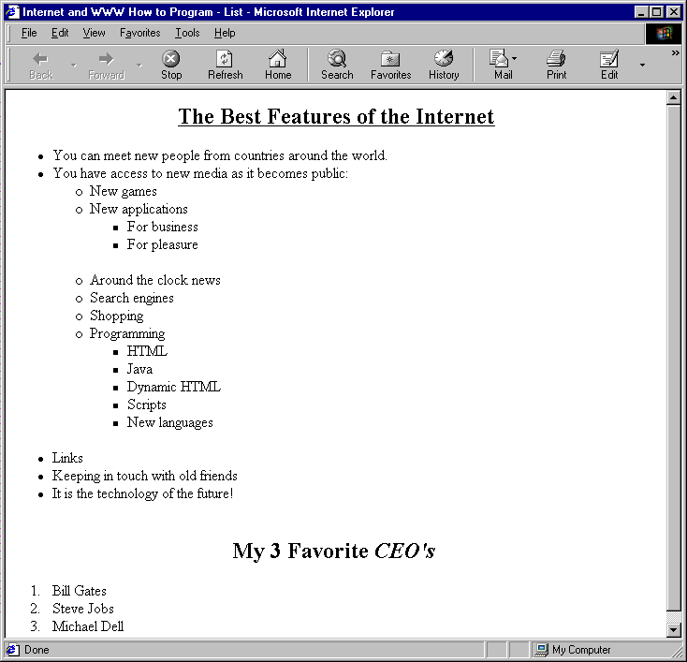
Nested unordered lists in HTML
<ul >
<li>.....</li>
<li>...</li>
<ul >
<li>.....</li>
<li>...</li>
</ul>
<li>....</li>
</ul>

Slide 9
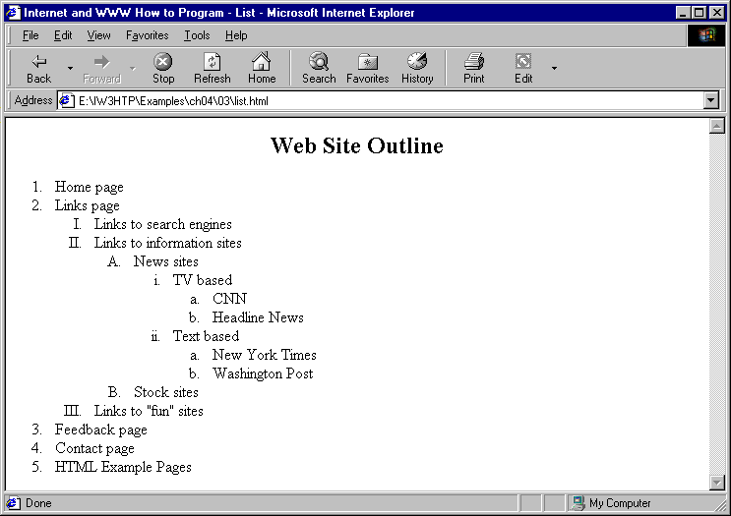
Similarly nested ordered lists

Slide 10
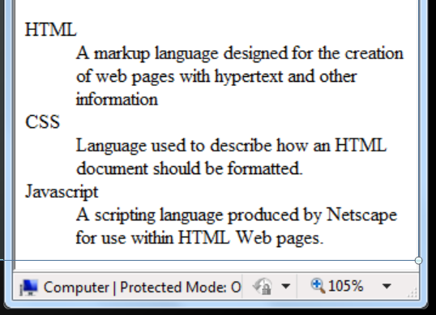
Definition lists: <dl>,<dt>,<dd>
<dl>
<dt>HTML</dt>
<dd>A markup language designed …</dd>
</dl>
<dl>
<dt>CSS</dt>
<dd>Language used to describe…....</dd>
</dl>
<dl>
<dt>Javascript</dt>
<dd>A scripting language produced ..</dd>
</dl>

Slide 11
HTML special characters
.
Symbol Name
HTML Entity
Symbol
Copyright Sign
&copy;
©
Registered Trademark Sign
&reg;
®
Trademark Sign
&trade;
™
Less Than
&lt;
<
Greater Than
&gt;
>
Ampersand
&amp;
&
Non-breaking Space
&nbsp;
Em Dash
&mdash;
—
Quotation Mark
&quot;
"
Euro
&#8364;
€
British Pound
&pound;
£
Japanese Yen
&yen;
¥

Slide 12
<div>
<div></div>
<div> creates logical divisions within a page
It is block level element, add a line break before and after them
<span>
<span></span>
Useful for modifying or formatting specific portion of text
It is inline element, i-e, It does not add line break before and after
Both <div> and <span> are used with CSS
We will cover CSS later.

Slide 13
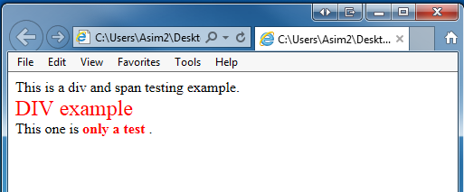
.
<div style="font-size:24px; color:red">DIV example
</div>
This one is <span style="color:red; font-weight:bold"> only a test </span>.

Slide 14
.
Div Example with CSS:
<!DOCTYPE html>
<html><head>
<style>
.box {
border: 2px solid blue;
padding: 10px;
margin: 10px 0;
}
</style></head>
<body>
<div class="box">
<h2>This is a Div</h2>
<p>The div tag is a block-level element used to group content.</p>
</div></body></html>

Slide 15
Span Example with CSS:
<!DOCTYPE html>
<html>
<head>
<style>
.highlight {
color: red;
font-weight: bold;
}
</style></head>
<body>
<p>This is a <span class="highlight">highlighted</span> word in a sentence.</p></body>
</html>

